Slide 1

Girls Who Code Teacher Training
Object Oriented Programming
‹#›
Notes:
Session plan found here: https://docs.google.com/document/d/1-rtG9QWBIygUcapxW4HBTEETCKfW_h-LbZxDWavTrkw/edit

Slide 2
HOOK
Find a partner you haven’t met yet. Introduce yourselves, and then fill in the blanks below:
Life is like a [BLANK].
I’m as [BLANK] as a [BLANK] in [BLANK].
Notes:
3 min to find a partner to talk.
1 min to share out/return to seats
1 min - Analogies and connections to real life are great ways to explain these coding concepts to students. We are going to leverage this during this session.

Slide 3
OBJECTIVES
By the end of this session, GTWBAT:
Identify how Object Oriented Programming (OOP) fits into the scope of the Summer Immersion Program.
Understand how using analogies and gallery walks can help students understand CS Concepts
Name their own next steps for practicing OOP
Notes:
Call on a teacher to read this
GTWBAT = Great teachers will be able to
Say:
What this is, what this isn’t:
It is going to give you some time to refresh introductory vocabulary.
It isn’t going to teach you everything about object oriented programming.
It is going to connect you to resources where you can refresh your syntactical skills
It isn’t going to teach you all of the dots, commas and colons you need to create your own class.

Slide 4

Interaction Meter
Interaction mode: You’ll be observing, participating, and leading at different times during this session. If you are ever confused what your role or task is, ask a neighbor or raise your hand.
I DO | WE DO | YOU DO

Slide 5
Teaching Move
POSITIVE PRAISE
Praising a specific accomplishment or effort, not an ability
POSITIVE PRAISE
Remember: when we use it, you’ll see this icon on the slide!

Slide 6
CONTENT IN CONTEXT
Unit 1: Fundamentals
Unit 2: Applications
Unit 3: Advanced Topics
Unit 4:
Final Projects
When?: Week 5
Why?: OOP will allow girls to create more elegant, manageable and modular programs.
Related Project?: The Social Network
Notes:
< 1 min
Pause to give them time to read.
Say: The content we are going to learn and experiment with during this session falls near the end of SIP, after girls have learned all of the rest of their content.

Slide 7


CURRICULUM FUNNEL
Learner Profile
and
Essential Questions
Big Picture
Unit Plans
Lesson Plans
Your
Decisions
Small Moments
Notes:
< 1 min
Say: We are going to be operating at the lesson/decision level for the next 90 minutes, but we’ll pull out and look bigger picture at the end.

Slide 8
Decision Making Framework
Advocate for all students
Make your thinking visible
Build more than code

Slide 9
WHERE ARE WE NOW?
Hook - 5 Min
Objectives, Context and Agenda - 5 Min
Gallery Walk: Connecting to Real-Life - 15 min
Practice: Introducing Classes and Objects - 10 min
Syntax Work Time: Social Network Project - 30 min
Reflection and Closing - 5 min

Slide 10
MAKING GROUPS
Count off by 6 at your table.
Find your number in your designated color.
PURPLE | RED | ORANGE | GREEN
Tables 1-4 | Tables 5-8 | Tables 9-12 | Tables 13-15

Slide 11
PART 1: COLLABORATE
(5 minutes)
Find your group and introduce yourselves.
Then, list all of the qualities and functionalities of your item.
Notes:
Pre-sort groups. Suggestion - hand people cards when they walk in.
As groups work, circulate and pull out interesting examples.

Slide 12
PART 2: GALLERY WALK
(3 minutes)
Walk around and read through the work of other groups. As you walk, consider:
What do the items of other groups have in common with your item? What distinguishes them?
Notes:
Do this silently.
Set a timer.

Slide 13
PART 3: SHARE OUT
POSITIVE PRAISE
If we had to group all of the items together, what would we call this large group?
What are different sub-categories that we might have within this class?
Did the gallery walk help you understand these concepts? How about the analogy?
Notes:
Take notes on the board to draw something like this: http://www.ibm.com/developerworks/lotus/library/ls-object_oriented_LotusScript/figure2.gif
Answer to question 1:
Vehicles - This is like a CLASS in an OOP language (like Python). A class is basically defining a data type or structure that you can interact with in ways that you define.
All vehicles have some commonalities. What are things that all groups had in common?
Every one of these vehicles is an instance of the class - it is like a blueprint of what you need to create a piece of data that has the same fields
Every one of these vehicles has some of the same functionality - these are methods.
Answer to question 2:
Cars, Trucks, Planes
In OOP, this idea is inheritance. You can take the blueprint for a datatype and use it as a starting point for more specific objects.
For example, if I started a car class, I would have the same things as the vehicle class. However, I might add some special methods or fields.
What fields might I add?
What methods might I add?
Why use objects - because it allows you to easily customize new structures that you can use over and over again in different programs. It also allows you to make changes - you can update the fields of your object in the class without having to change it everywhere in your code.

Slide 14
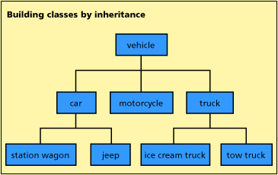
Notes:
Take notes on the board to draw something like this: http://www.ibm.com/developerworks/lotus/library/ls-object_oriented_LotusScript/figure2.gif
Answer to question 1:
Vehicles - This is like a CLASS in an OOP language (like Python). A class is basically defining a data type or structure that you can interact with in ways that you define.
All vehicles have some commonalities. What are things that all groups had in common?
Every one of these vehicles is an instance of the class - it is like a blueprint of what you need to create a piece of data that has the same fields
Every one of these vehicles has some of the same functionality - these are methods.
Answer to question 2:
Cars, Trucks, Planes
In OOP, this idea is inheritance. You can take the blueprint for a datatype and use it as a starting point for more specific objects.
For example, if I started a car class, I would have the same things as the vehicle class. However, I might add some special methods or fields.
What fields might I add?
What methods might I add?
Why use objects - because it allows you to easily customize new structures that you can use over and over again in different programs. It also allows you to make changes - you can update the fields of your object in the class without having to change it everywhere in your code.

Slide 15
OOP VOCABULARY
WORD | DEFINITION | ANALOGOUS IDEA
Class | The blueprint or rules for new data types, or objects, that you can define. | The design blueprint for a vehicle.
Object/ Instance | An actual structure that is built with the fields and methods as defined by the class. | Group A actual Vehicle or Group B actual Vehicle
Field/ Attribute | A specific piece of data that is held within an object in a class. | All vehicles have wheels and windows.
Method | The specific things that objects can do. They are like object-specific functions. | Vehicles can “stop”
Inheritance | The ability for new classes or objects to be based on others, when they have an “is-a” relationship. | A car is a vehicle, so it inherits all of the qualities of a vehicle.
Notes:
< 1 min
Share this slide. Put it up during independent planning time in the next session, and tell teachers they might want to revisit it as a reference later.

Slide 16
GALLERY WALK QUESTIONS
What are the potential benefits of this activity?
How is this different from how you may have first learned about OOP?
Or, is this making these concepts more accessible to you? Why or why not?

Slide 17
WHERE ARE WE NOW?
Hook - 5 Min
Objectives, Context and Agenda - 5 Min
Gallery Walk: Connecting to Real-Life - 15 min
Practice: Introducing Classes and Objects - 25 min
Syntax Work Time: Social Network Project - 20 min
Reflection and Closing - 10 min

Slide 18
WHERE ARE WE NOW?
Hook - 5 Min
Objectives, Context and Agenda - 5 Min
Gallery Walk: Connecting to Real-Life - 15 min
Practice: Introducing Classes and Objects - 10 min
Syntax Work Time: Social Network Project - 30 min
Reflection and Closing - 5 min

Slide 19
PRACTICE: INTRODUCING OBJECTS
(5 minutes for planning)
Scenario:
Imagine that you’ve done this Gallery Walk with your class already, and that you’ve used the vehicle analogy once. You have a student who just doesn’t get it!
Come up with another analogy or another technique to explain the concept of objects and the related vocabulary to this student.
Notes:
< 1 min
Share this slide. Put it up during independent planning time in the next session, and tell teachers they might want to revisit it as a reference later.

Slide 20
OOP VOCABULARY
WORD | DEFINITION | ANALOGOUS IDEA
Class | The blueprint or rules for new data types, or objects, that you can define. | Vehicles
Object/ Instance | A piece of data that has all of the fields and methods as defined by a class. | Group A’s Vehicle or Group B’s Vehicle
Field | The specific data that is held within an object in a class. | All vehicles have wheels and windows.
Method | The specific ways to interact with an object in a class. | You can move vehicles from point A to B.
Inheritance | The ability for new classes or objects to be based on others, when they have an “is-a” relationship. | A car is a vehicle, so it inherits all of the qualities of a vehicle.

Slide 21
PRACTICE: INTRODUCING OBJECTS
POSITIVE PRAISE
Rejoin your groups of 4. Determine whose birthday is coming up next - this person will present first.
3 Min - First presenter shares their analogy. Other members pretend to be the students.
2 min - “Students” give the presenter feedback.
Focus your feedback around clarity and presence, and aim to be specific and actionable.
Repeat until everyone has been the teacher.
Notes:
20 min
Circulate to make sure groups are practicing.
At the end of this time, shout out any particularly creative analogies or techniques.

Slide 22
WHERE ARE WE NOW?
Hook - 5 Min
Objectives, Context and Agenda - 5 Min
Gallery Walk: Connecting to Real-Life - 15 min
Practice: Introducing Classes and Objects - 10 min
Syntax Work Time: Social Network Project - 30 min
Reflection and Closing - 5 min

Slide 23
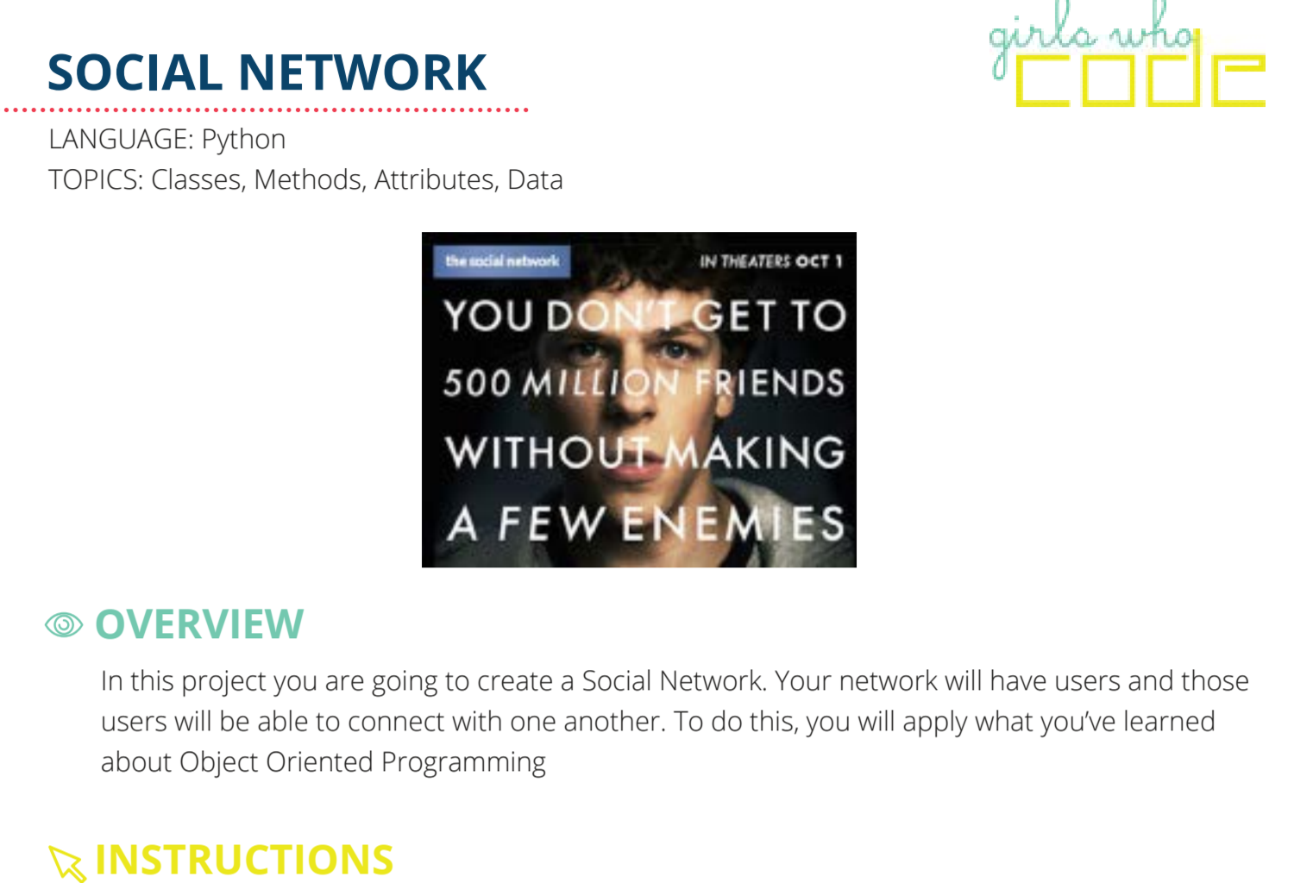
SYNTAX WORK TIME: SOCIAL NETWORK
Notes:
Email out these resources (needs updating)
Student Prompt
Resources for syntax
Starter Code
GWC thing
Really boring video - https://www.youtube.com/watch?v=lbXsrHGhBAU

Slide 24
SYNTAX WORK TIME: GROUPS
(30 minutes)
A | B | C | D | E
This is new to me, so I want to work with an instructor or peer expert. | I want some quiet, heads down work time. | I haven’t started, and I want to partner up and think with someone. | I feel confident about this content and I want to help others learn. | I feel confident about this content, and I want to think about how I will teach it.
https://github.com/GirlsFirst/SIP-2017-starter
Notes:
Update based on room set-up

Slide 25
WHERE ARE WE NOW?
Hook - 5 Min
Objectives, Context and Agenda - 5 Min
Gallery Walk: Connecting to Real-Life - 15 min
Practice: Introducing Classes and Objects - 10 min
Syntax Work Time: Social Network Project - 30 min
Reflection and Closing - 5 min

Slide 26
REFLECTION: CURRICULUM FUNNEL
Learner Profile
and
Essential Questions
Unit Plans
Lesson Plans
Your
Decisions
Notes:
< 1 min
Say: We are going to be operating at the lesson/decision level for the next 90 minutes, but we’ll pull out and look bigger picture at the end.

Slide 27
REFLECTION: BIG PICTURE
Discuss with a partner:
How might learning about OOP inform or change a student’s answer to one of the Essential Questions below?
What is computer science?
What tools do computer scientists use to solve problems?
How and why do we use computer science to solve problems?
How might this project help girls build the qualities in the Learner Profile?
Notes:
< 1 min
Say: We are going to be operating at the lesson/decision level for the next 90 minutes, but we’ll pull out and look bigger picture at the end.

Slide 28
Training Progress
Friday | Saturday | Sunday
Classroom Mgmt | Django | Final Projects
How to Use Curriculum | OOP | SIP Simulation
Escalation Process | Diversity and Inclusion
Python |  | Training to Week 0
Robotics

Slide 29
CLOSING: HOW DID WE DO?
By the end of this session, GTWBAT:
Identify how Object Oriented Programming (OOP) fits into the scope of the Summer Immersion Program.
Understand how using analogies and gallery walks can help students understand CS Concepts
Name their own next steps for practicing OOP
Notes:
Call on a teacher to read this
GTWBAT = Great teachers will be able to
Say:
What this is, what this isn’t:
It is going to give you some time to refresh introductory vocabulary.
It isn’t going to teach you everything about object oriented programming.
It is going to connect you to resources where you can refresh your syntactical skills
It isn’t going to teach you all of the dots, commas and colons you need to create your own class.

Slide 30
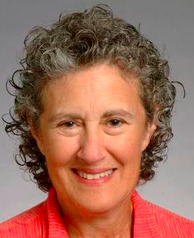
WOMAN IN TECH SPOTLIGHT
Barbara Liskov
Institute Professor at MIT
One of the first women to be granted a Ph.D in computer science in the United States.
Developed CLU, a programming language that is seen as a key step in the development of Object Oriented Programming.
Notes:
10 min
About institute professorships:
Institute Professor is the highest title that can be awarded to a faculty member at the Massachusetts Institute of Technology, a research university located in Cambridge, Massachusetts, United States. It is analogous to the titles of distinguished professor, university professor, or regents professor used at other universities in recognition of a professor's extraordinary research achievements and dedication to the school. At MIT, Institute Professors are granted a unique level of freedom and flexibility to pursue their research and teaching interests without regular departmental or school responsibilities; they report only to the provost.
About CLU:
CLU is a pioneering programming language created at the Massachusetts Institute of Technology (MIT) by Barbara Liskov and her students between 1974 and 1975. While it did not find extensive use, it introduced many features that are used widely now, and is seen as a step in the development of object-oriented programming (OOP). However, it is not object-oriented, instead being considered an object-based language, as it lacked many features of OOP.
Key contributions include abstract data types,^{[5]} call-by-sharing, iterators, multiple return values (a form of parallel assignment), type-safe parameterized types, and type-safe variant types. It is also notable for its use of classes with constructors and methods, but without inheritance.

